Slide 1
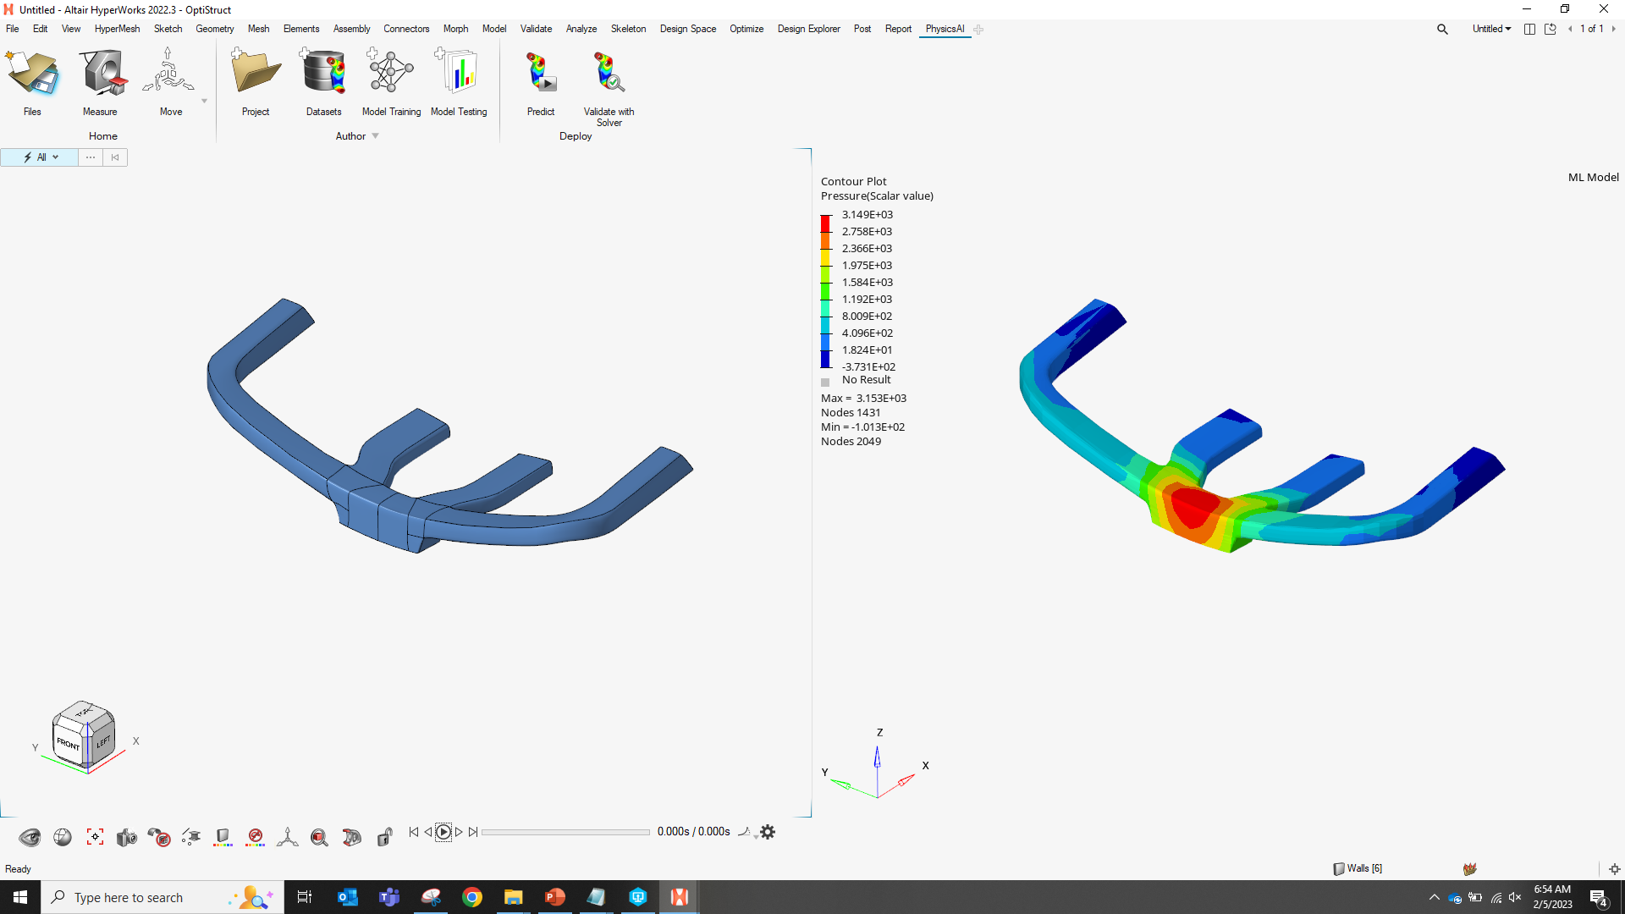
physicsAI
Eamon Whalen, Jonathan Ollar, Charles Mortished, Fatma Kocer
2/15/2023

Slide 2
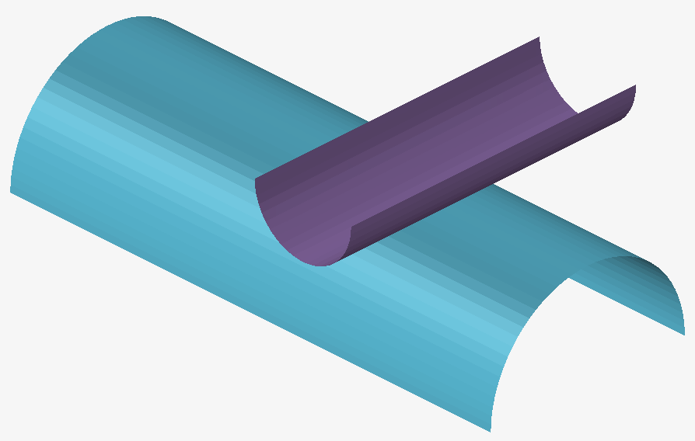
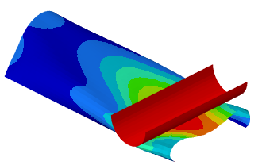

Altair physicsAI
Altair physicsAI delivers fast physics predictions
by learning from historical simulation data.
Model build
Simulation
physicsAI
First release 2022.3 (April)
Unlike other AI, physicsAI works directly on meshes or CAD.
Value to designers:
10x-100x faster than a solver
Reduce or eliminate model build time
Accelerated design and better design decisions

Slide 3
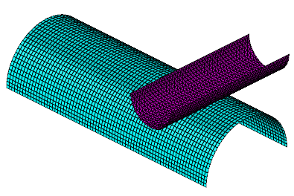
Altair physicsAI
physicsAI
GDL
mesh or CAD
HW Design Explorer*
ML
* Requires consistent meshes
contour
HyperStudy
ML
320 MPa
design variables
scalar

Slide 4
Examples

Slide 5




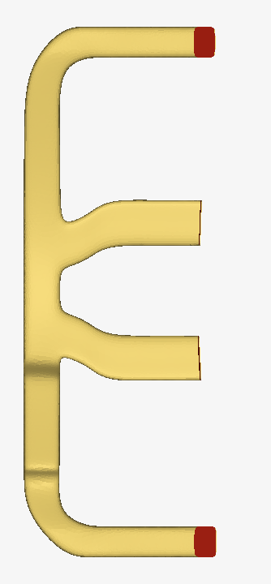
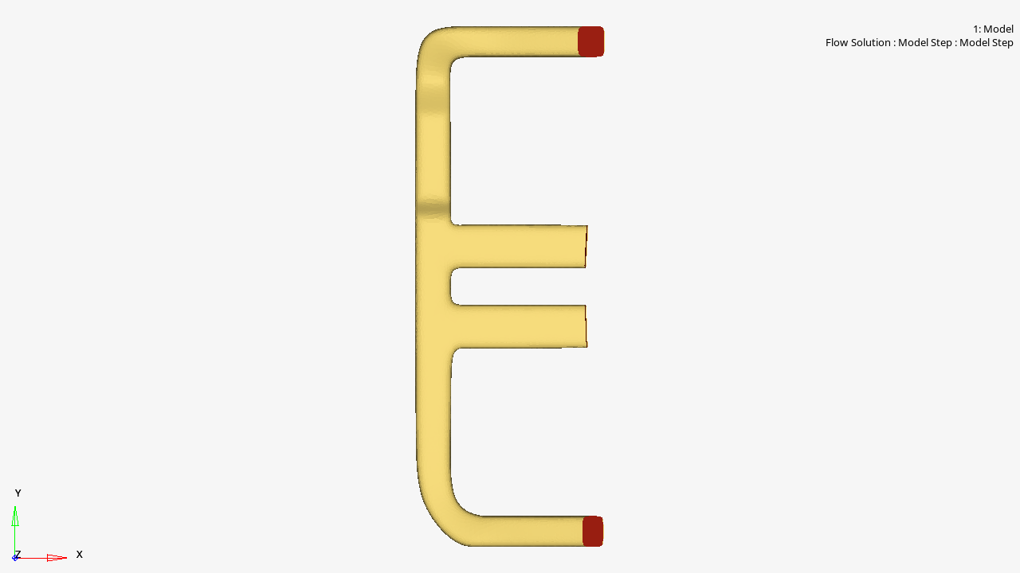
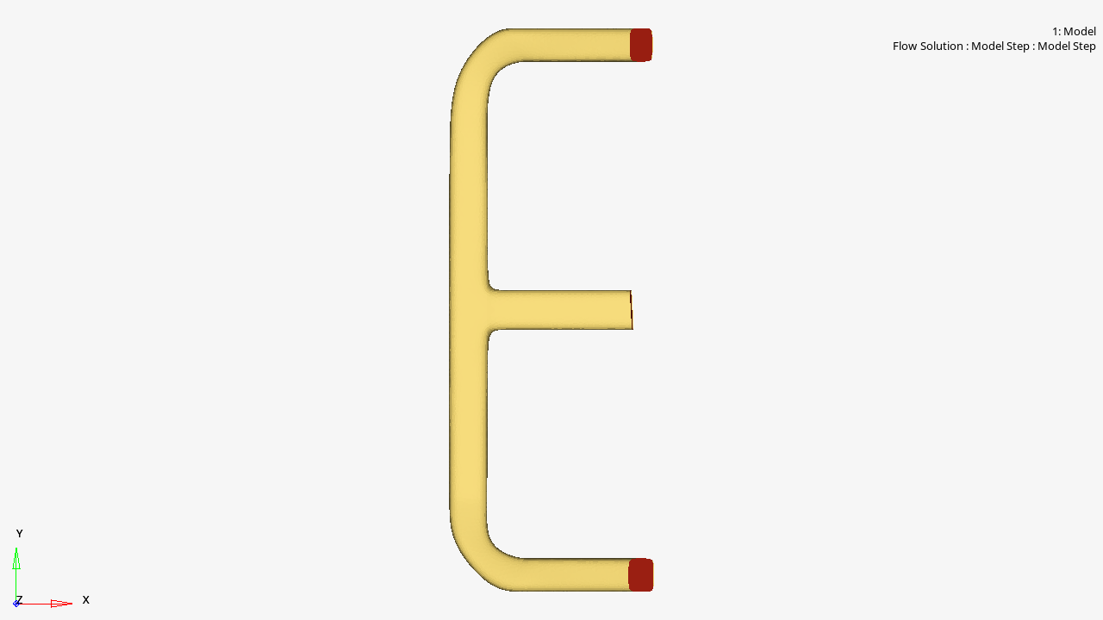
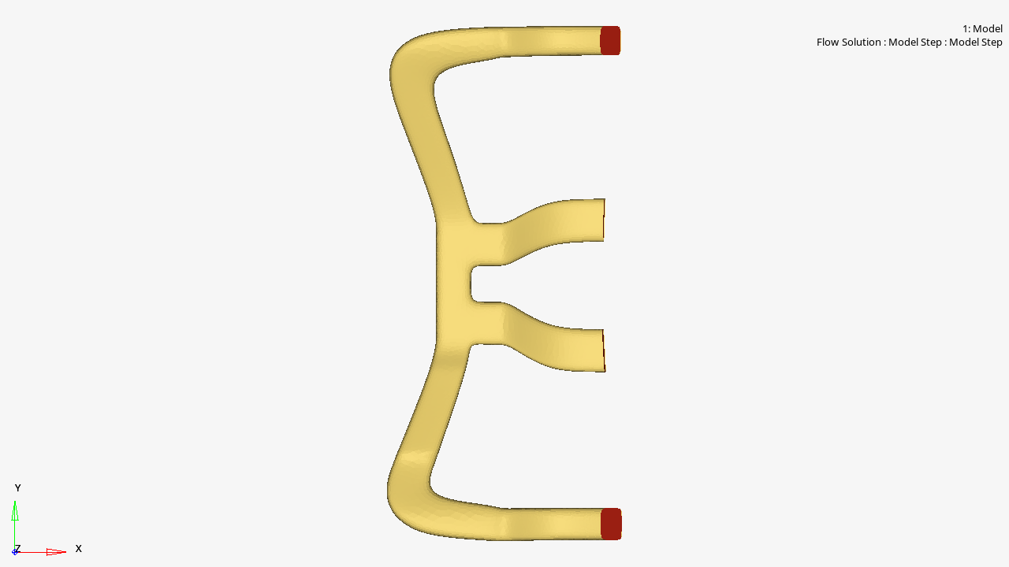

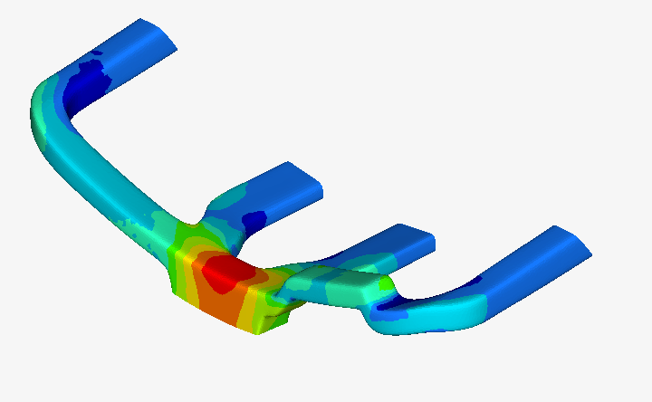

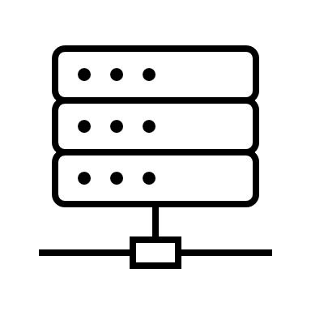
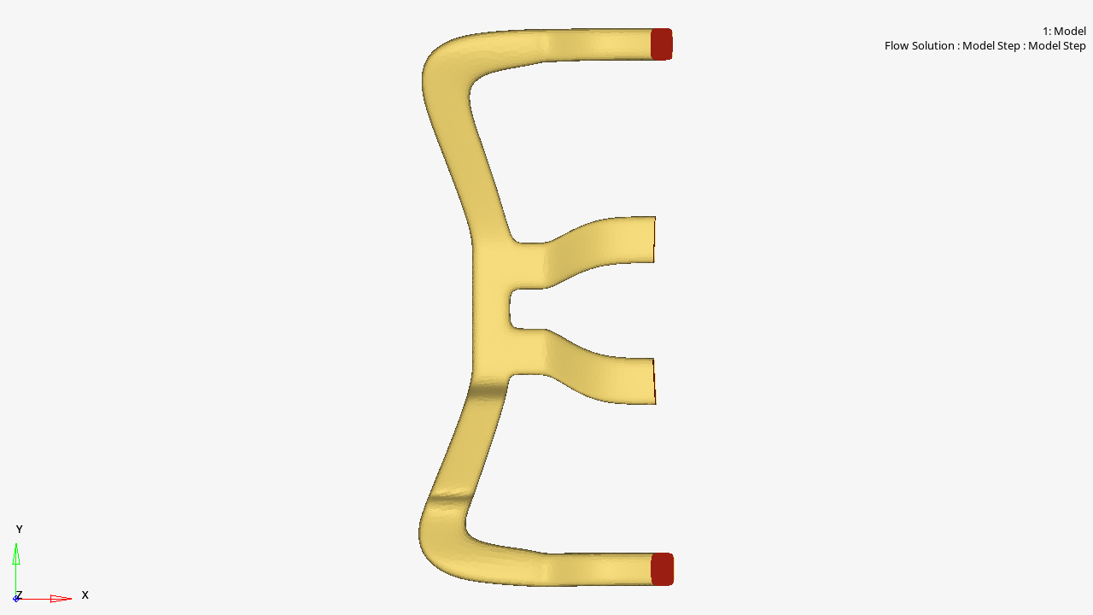

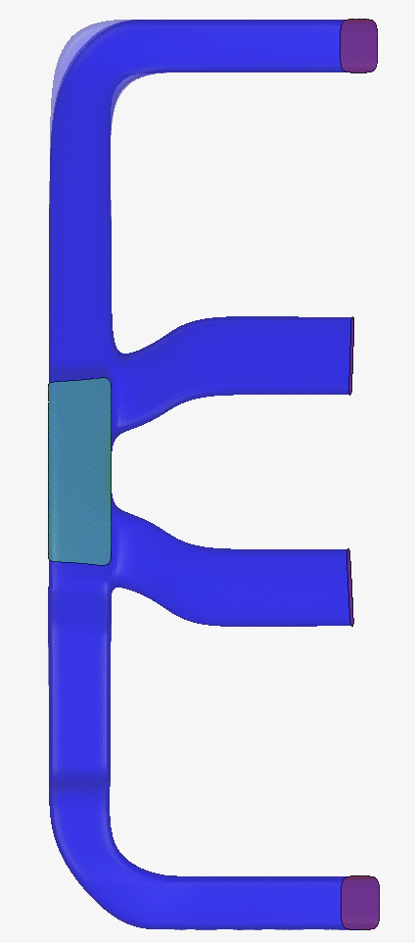
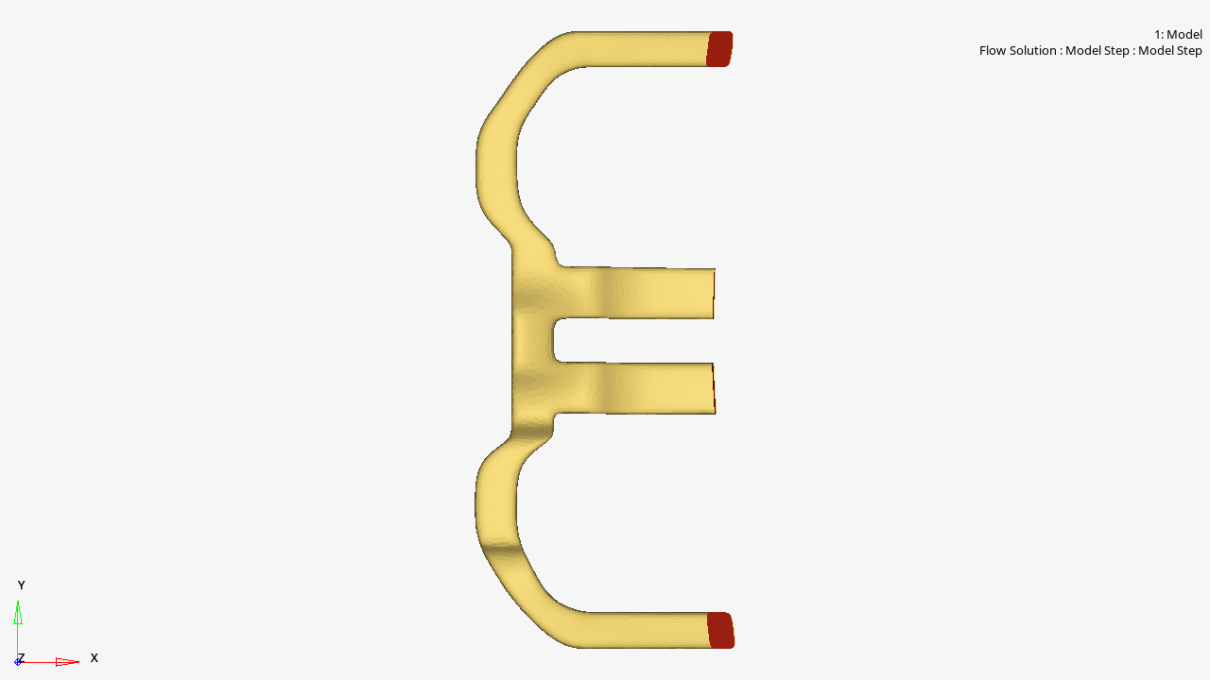
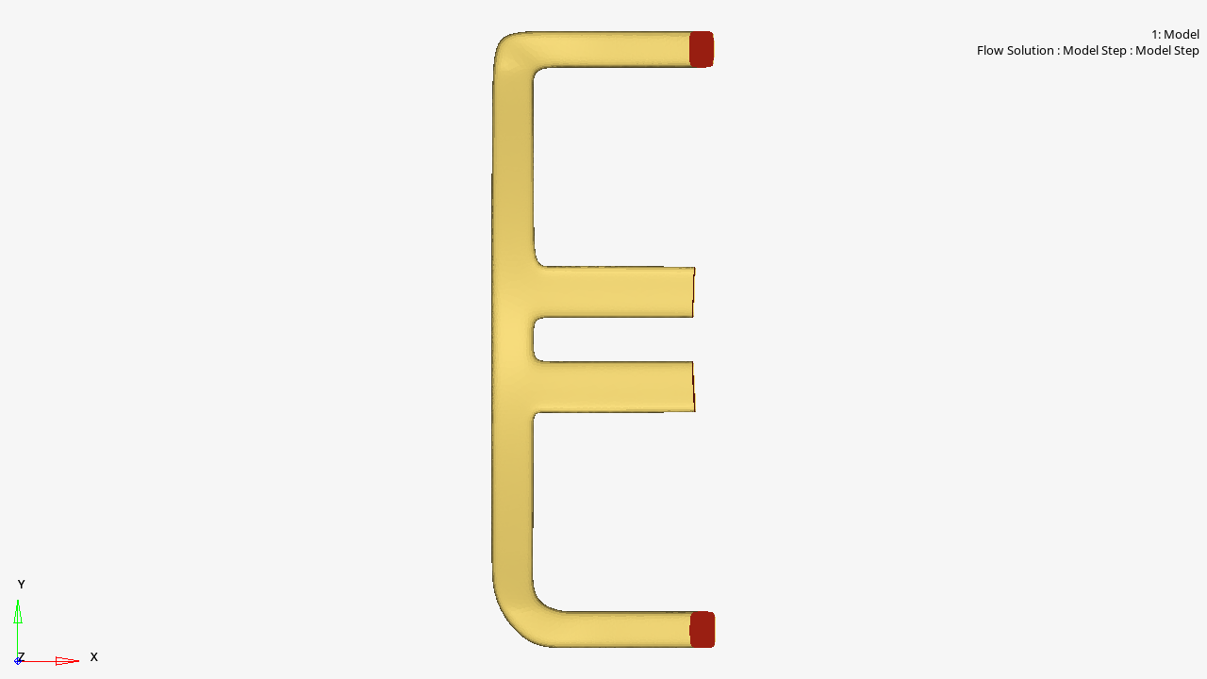
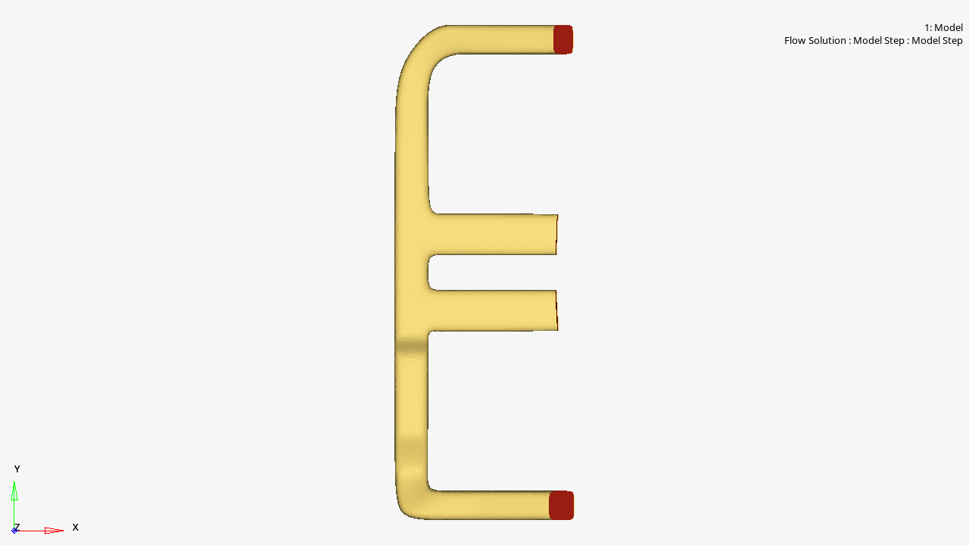
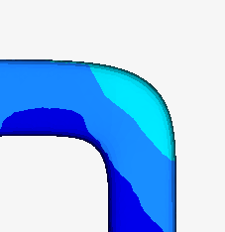
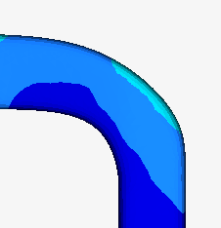
physicsAI: HVAC design shapeai
Accelerated design process
Historical data
Train physicsAI
Real-time exploration
Validate with solver
or
Local
Cloud
Des 1
Des 2
Des 3
New design
Real-time
AcuSolve
✔
Des 7
Des 4
Des 5
Des 6

Slide 6
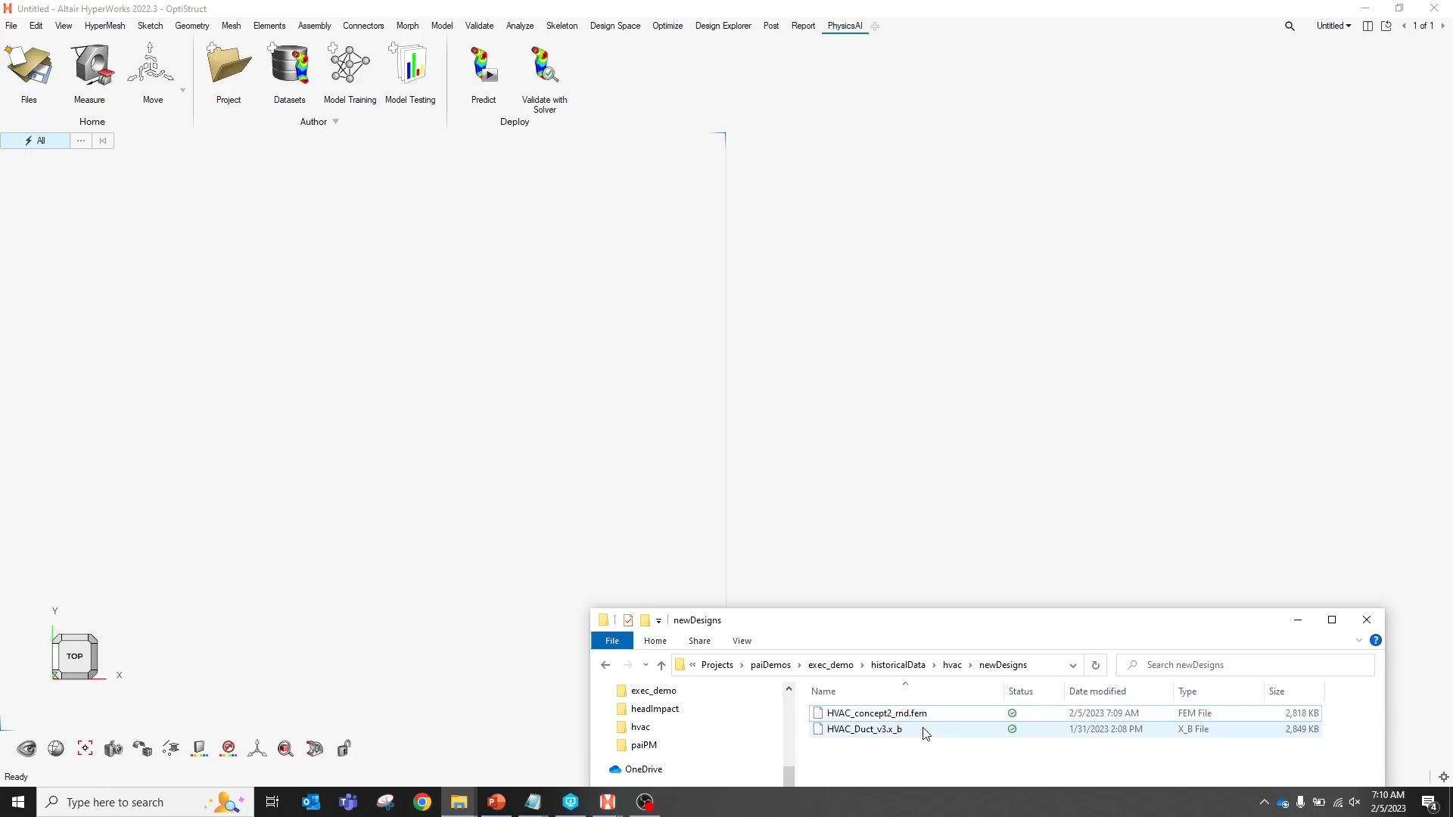
Real-time physics predictions

Slide 7
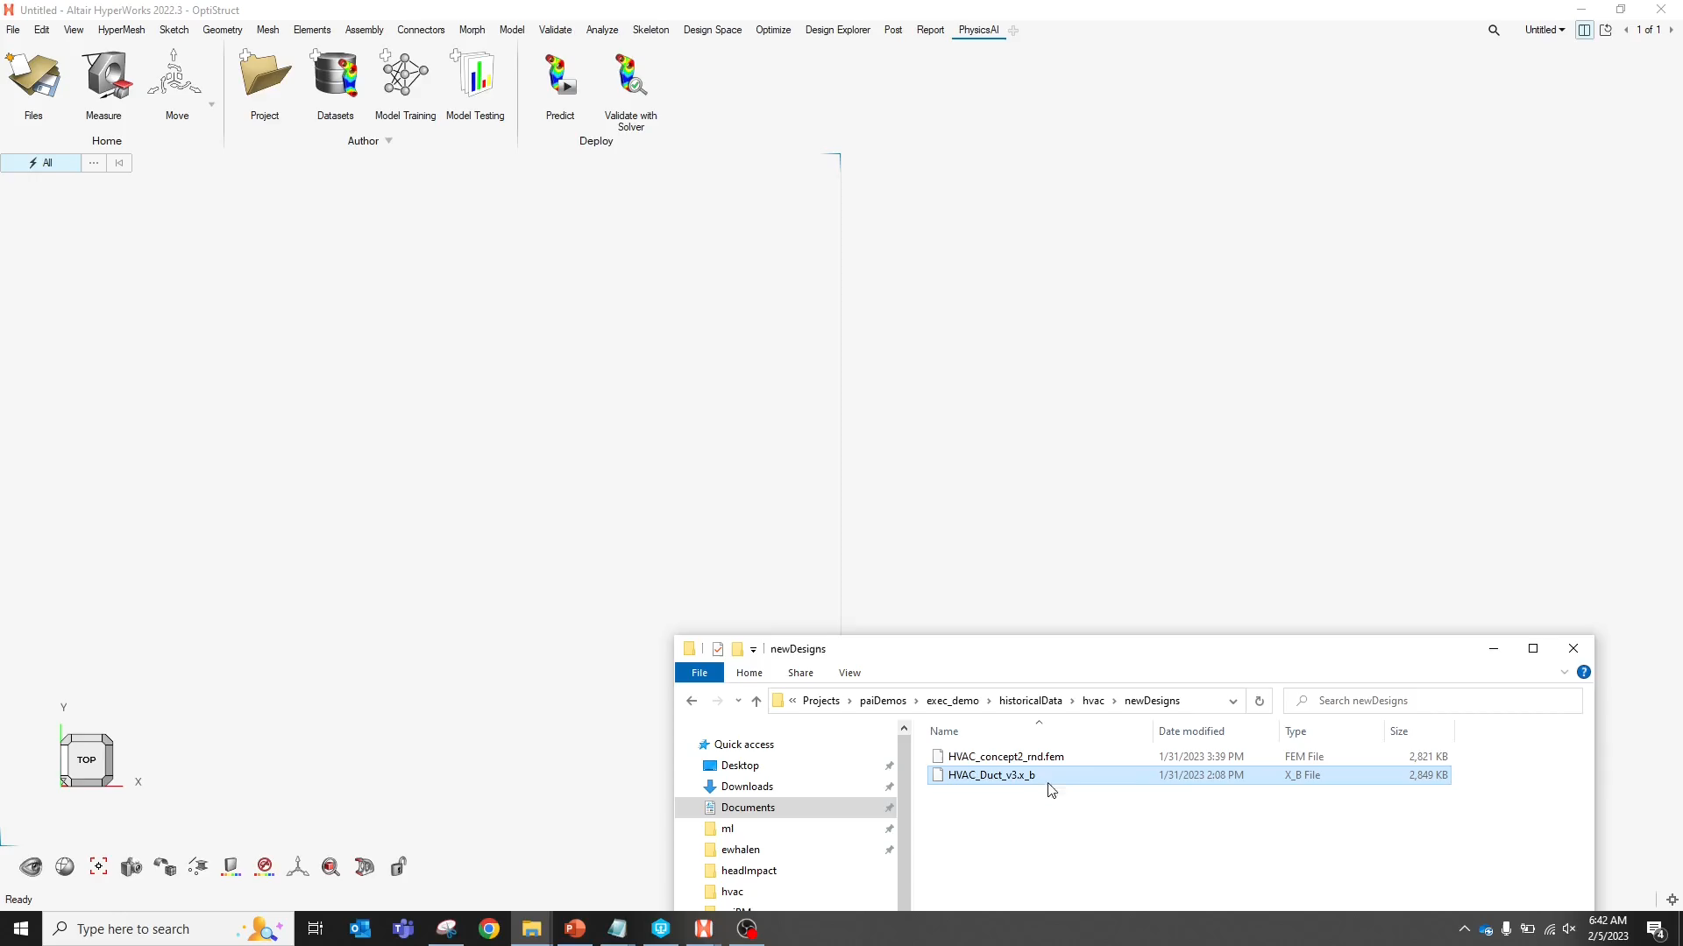
From CAD to contour
Notes:
Solver: 3m 26s, Train: 9m (7 samples, laptop), Predict: 3s (68x)

Slide 8
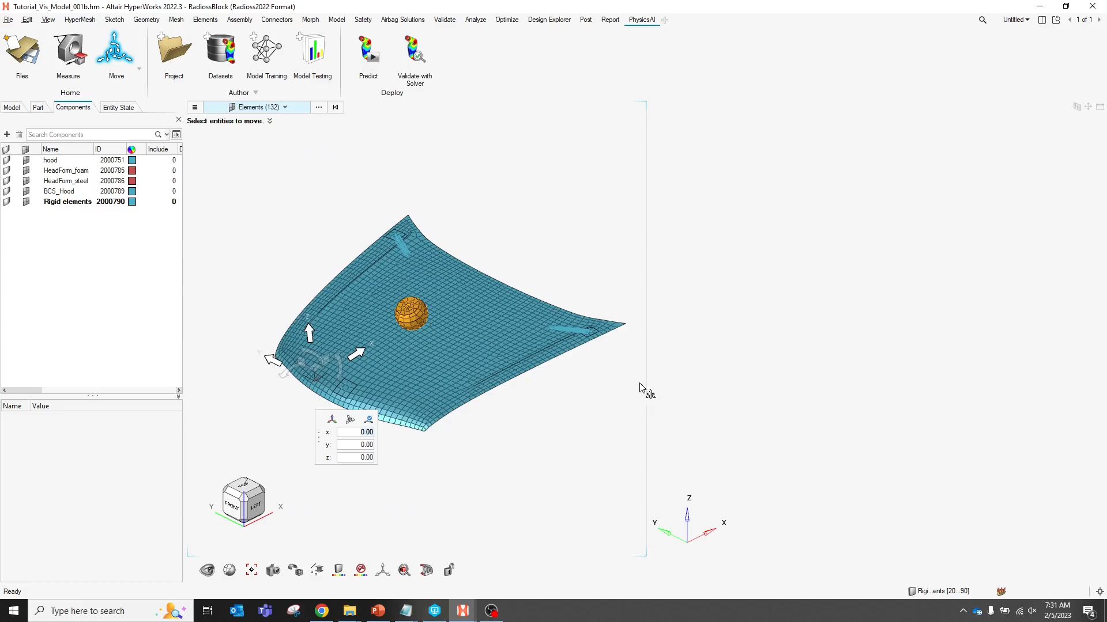
Crash example
Notes:
Solver: 2m 7s, Train: 20m (20 samples, laptop), Predict: 2.7s (47x)
Crash still WIP

Slide 9
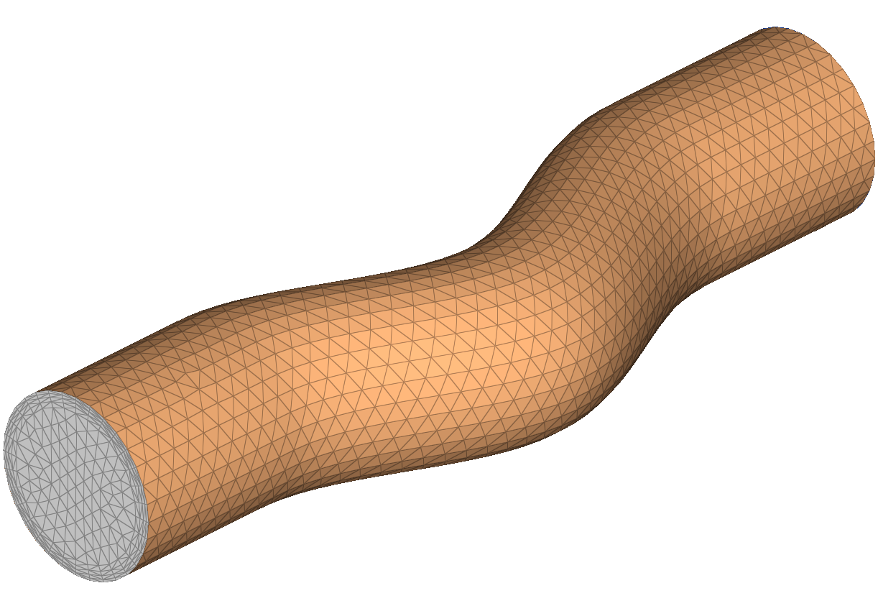
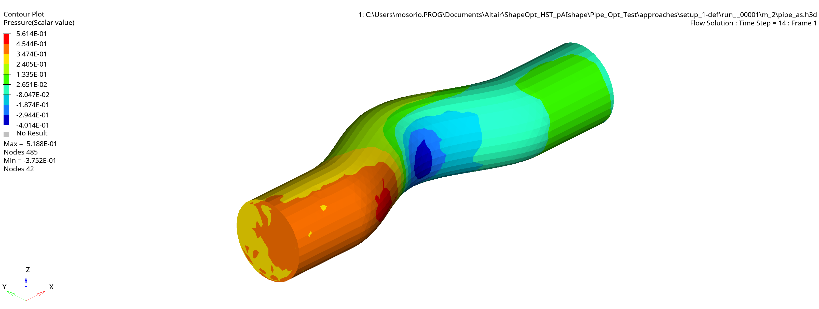
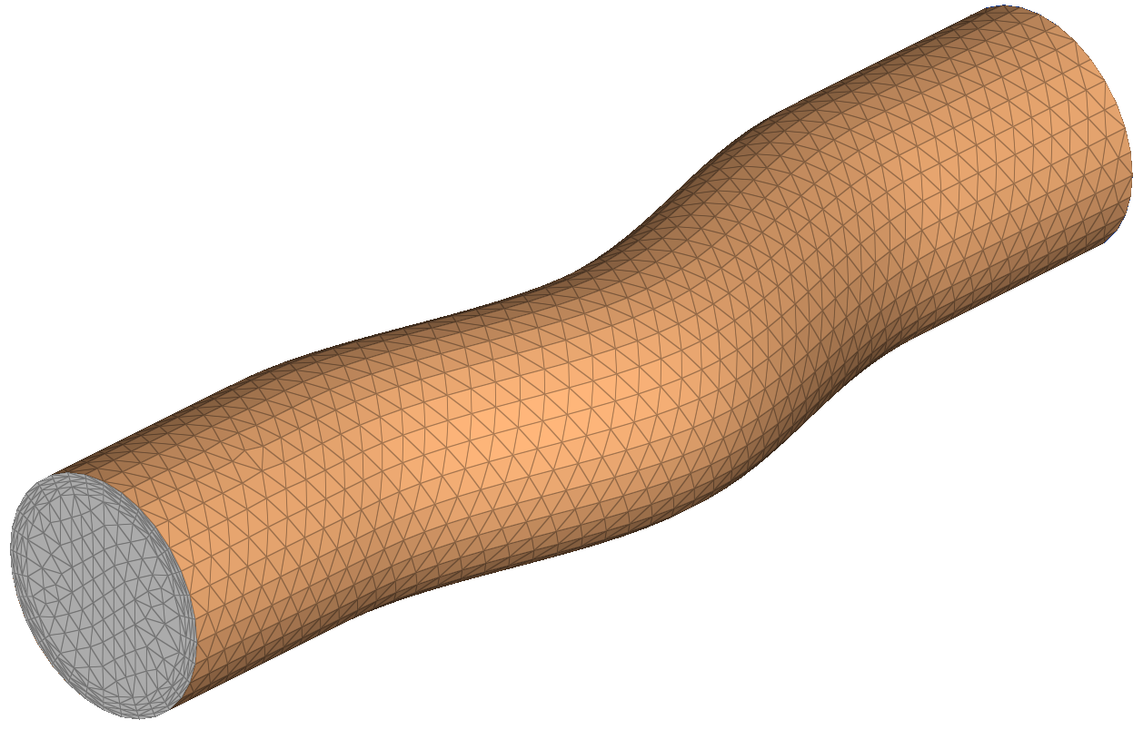



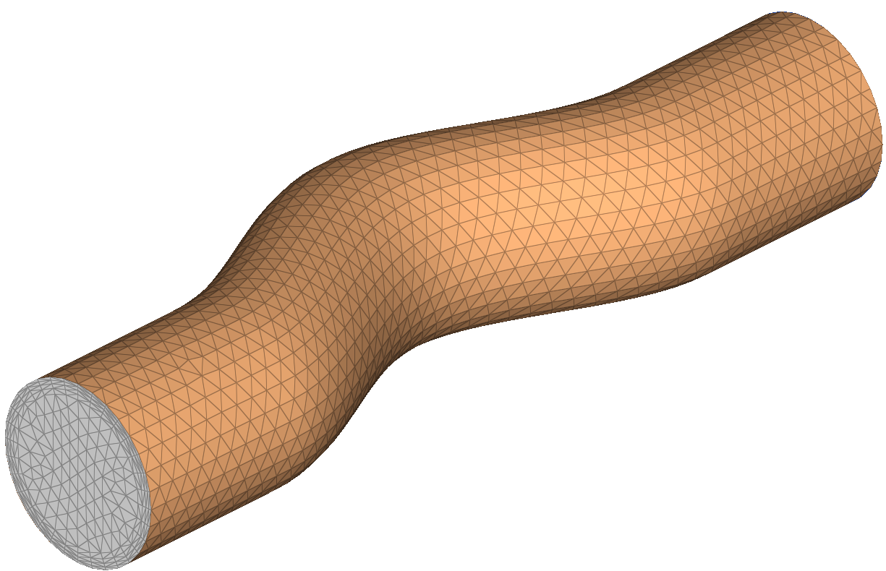
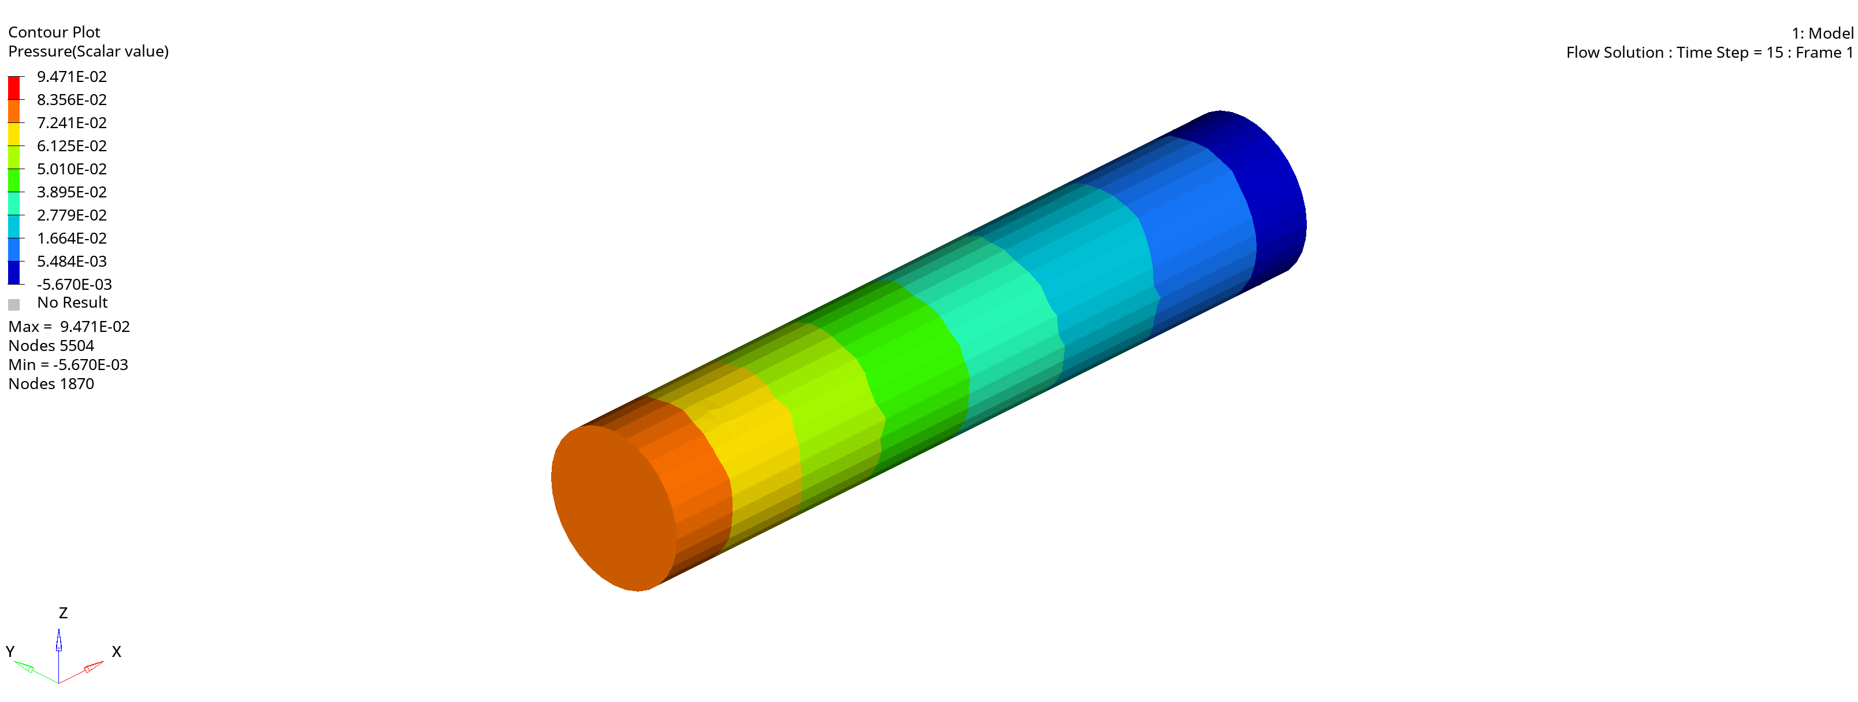
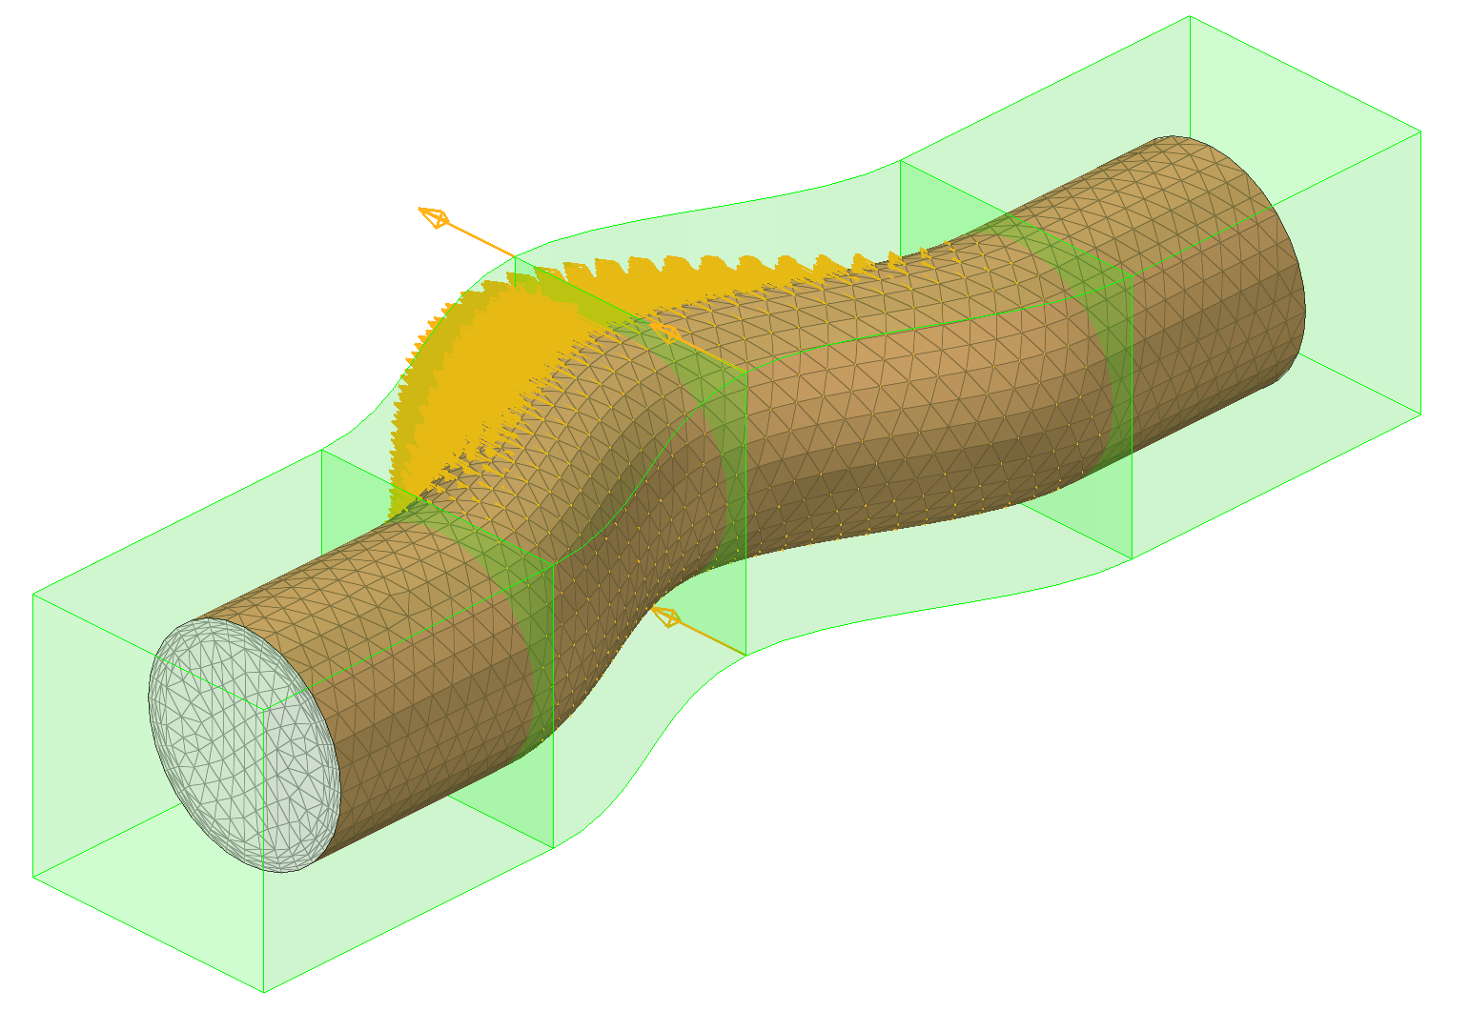
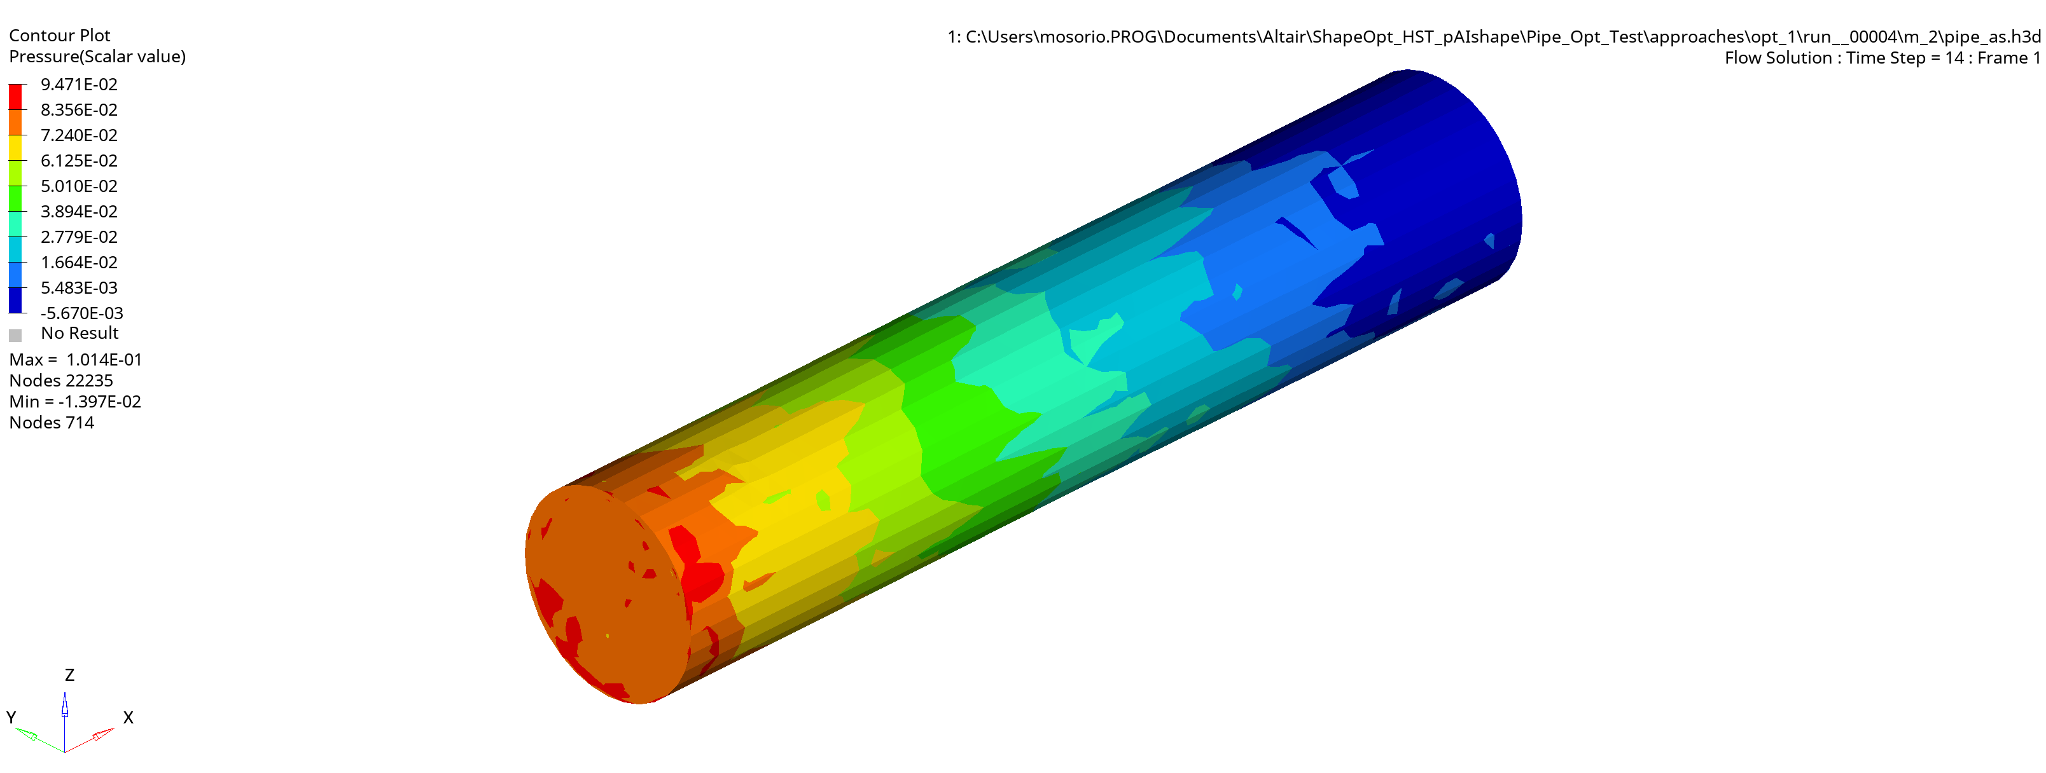
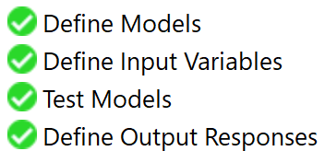
Shape optimization
1. Train
physicsAI
ML
physicsAI pressure contour
Create Data Set
Train ML Model
Predict
2. Optimize
HyperStudy
Analytical solution: shape = 0.00
HyperMorph shape
Shape optimization
Minimize
inflow pressure sum
Optimized: shape = 0.016

